Slide 1
Research & Development
From June 2020 to January 2021
Vesta Petrochem Co.

Slide 2
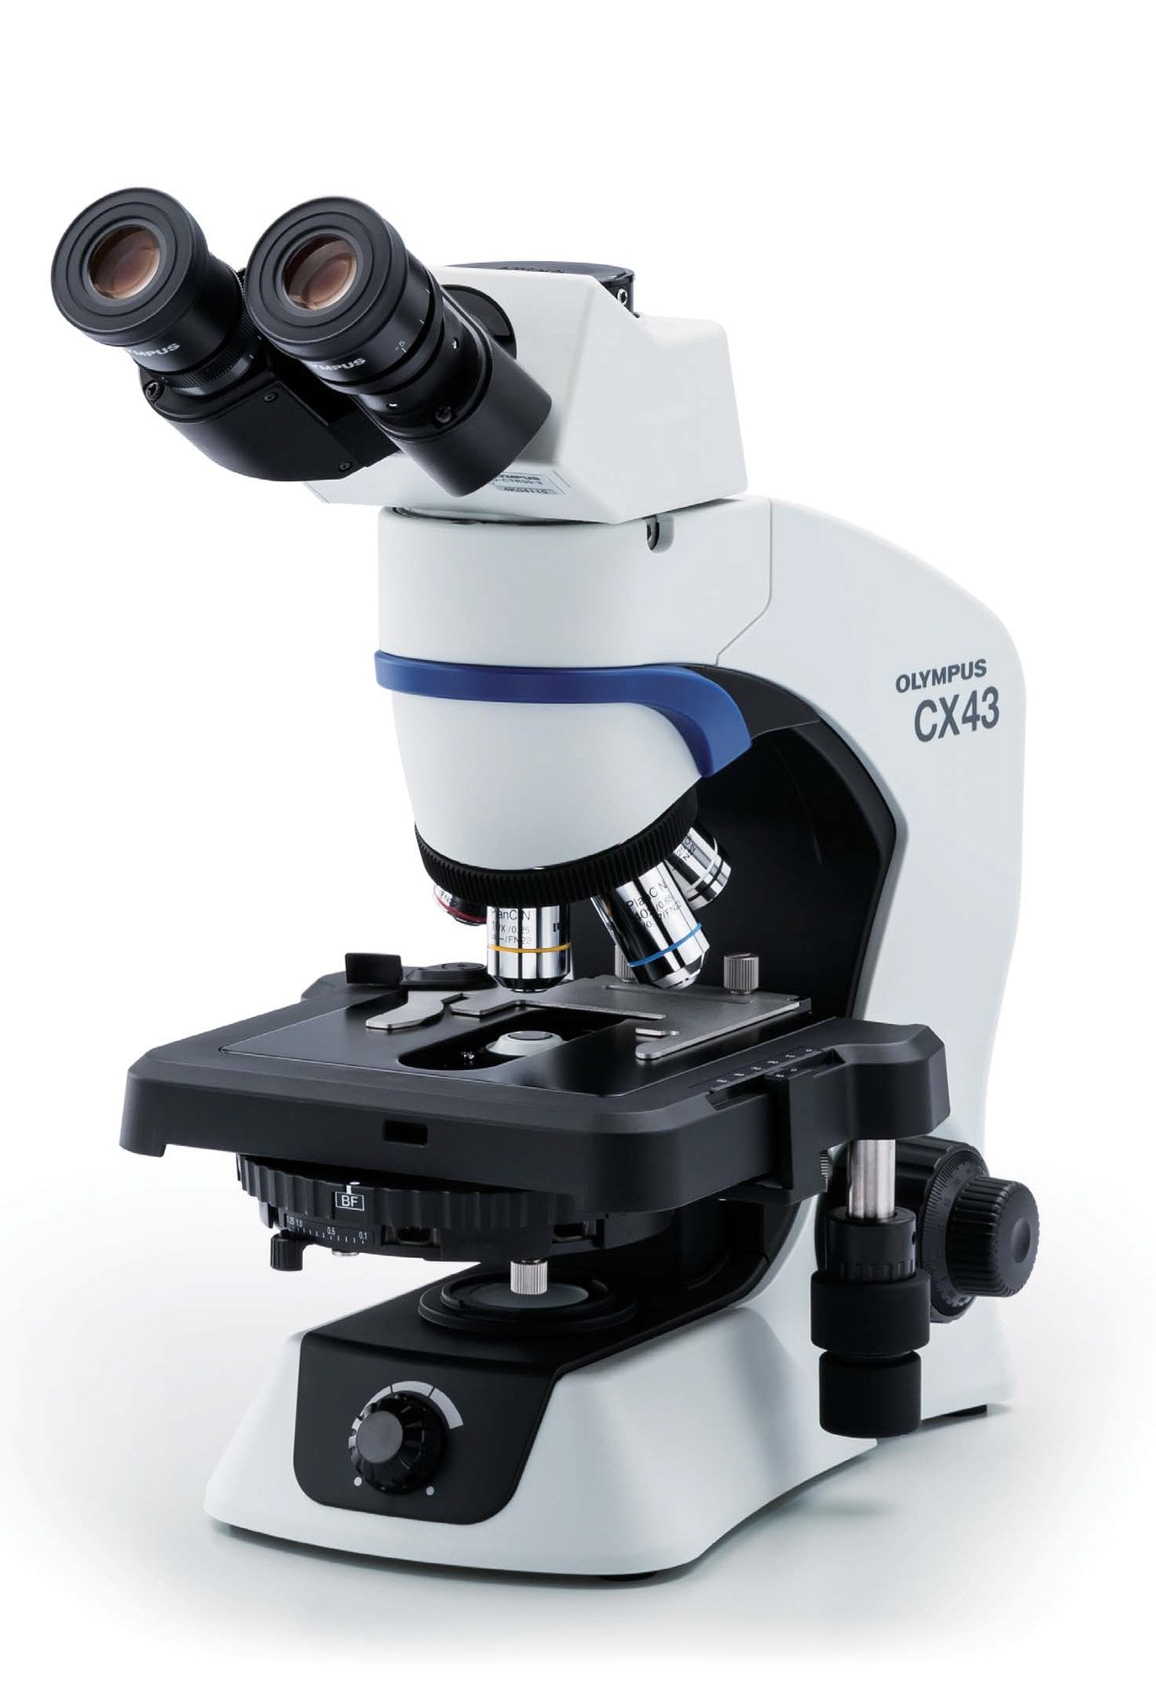
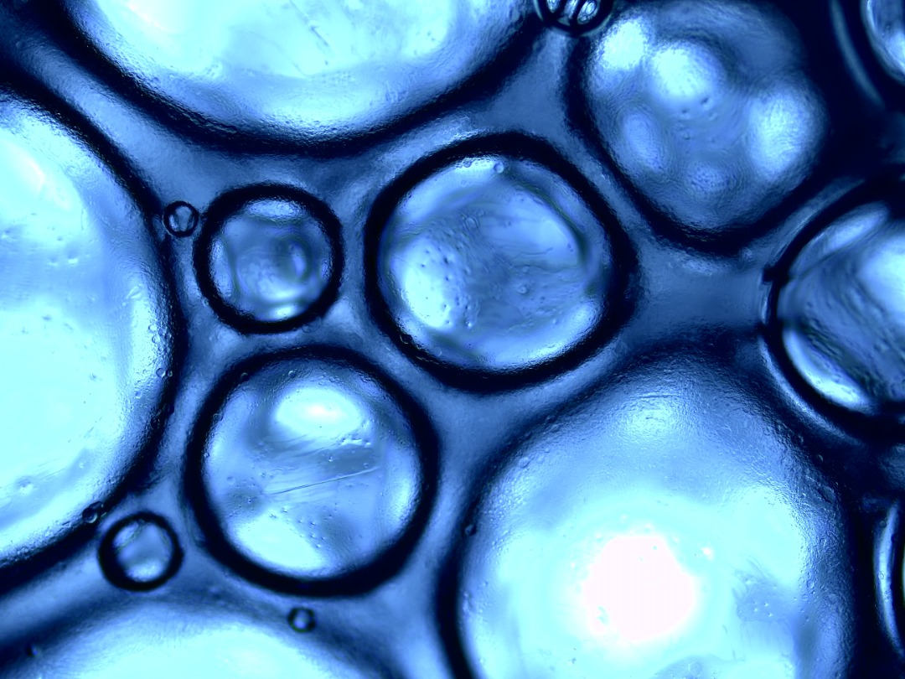
Olympus
Microscope, CX43
Magnifications: 80x, 200x, 800x, 2000x
Application: visual and qualificative analyses

Slide 3
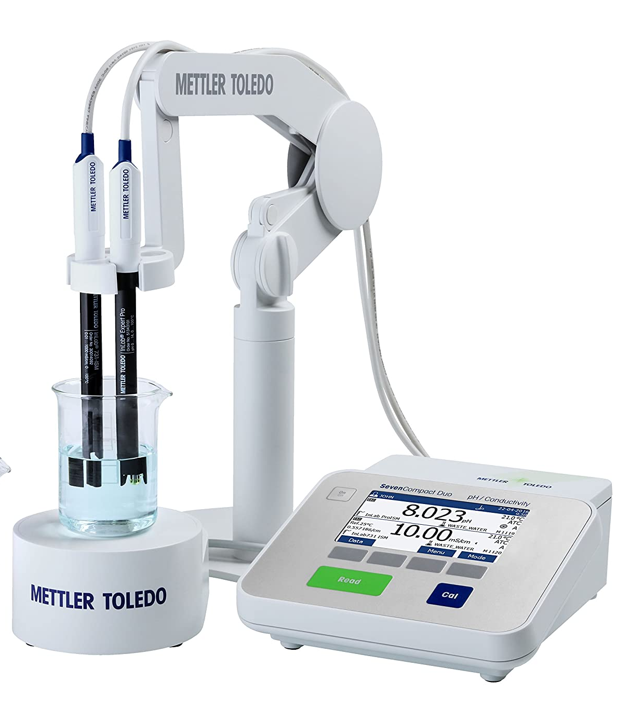
Mettler Toledo
pH-Conductometer
Precisian = 0.01 , 2 models simultanously
Application: titration for assessing the purity and pH
Note: pH meter gives the data, specialist convert them to diagram with excel

Slide 4
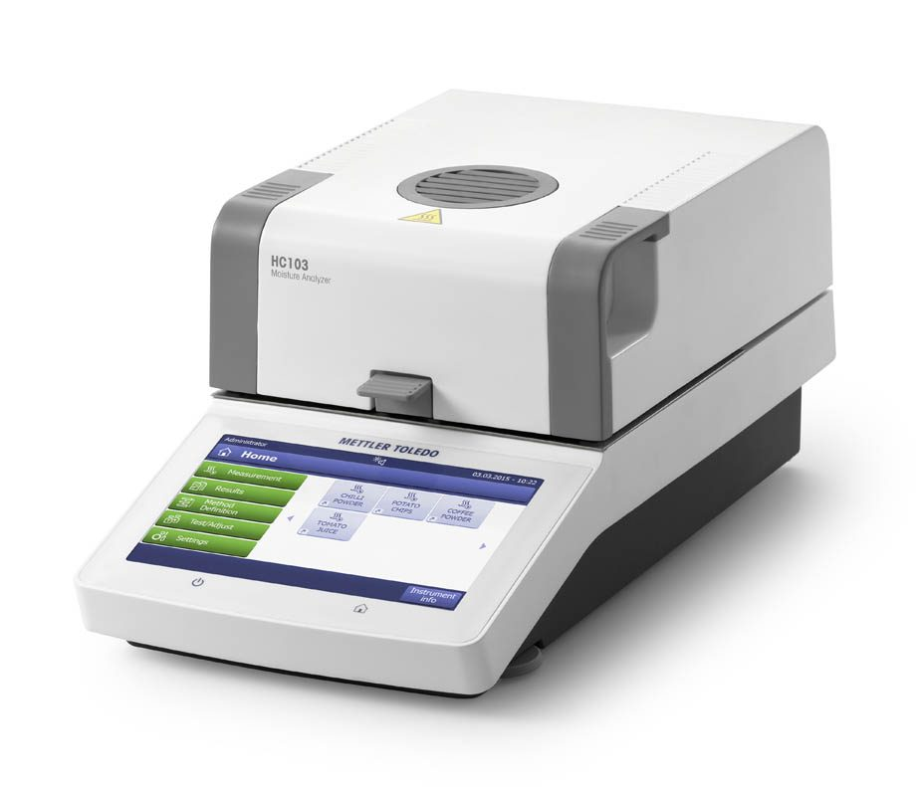
Mettler Toledo
Moisture Analyzer
Drying Temperature: 40 °C – 230 °C
Display Mode:
%AD; %AM; %DC; %MC; g; g/kg DC; g/kg MC

Slide 5
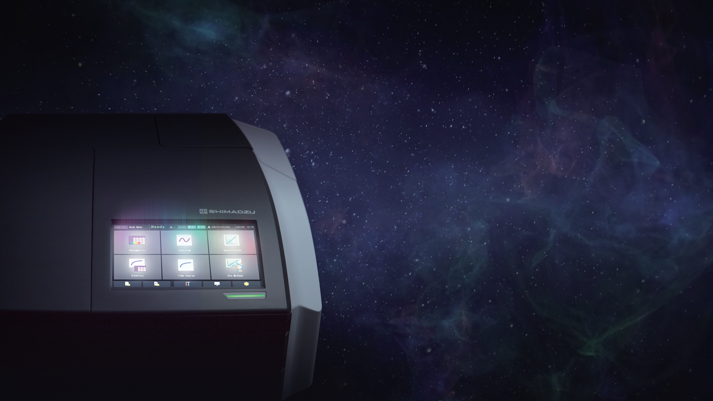
Shimadzu
UV-1900 Double beam
Wavelength range: 190 – 1000 nm
Wavelength Accuracy: ± 0.1 nm at D2 peak 656.1 nm, ± 0.3 nm for entire range

Slide 6
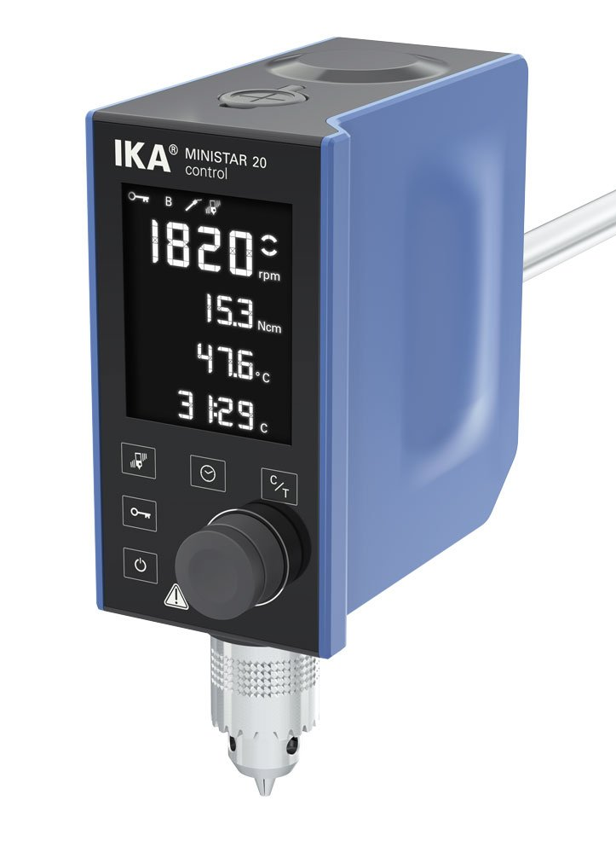
IKA
Mechanical Stirrer, Ministar 20
Speed max: 2000 rpm
Viscosity max: 10000 mPas

Slide 7
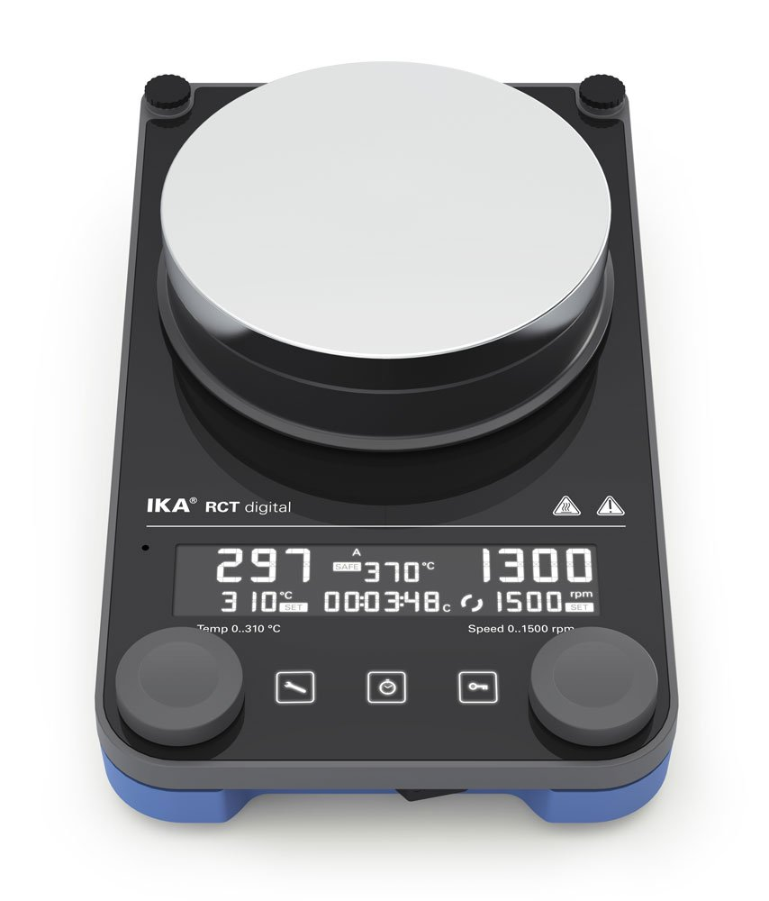
IKA
Hotplate-Magnet Stirrer, RCT Digital
Speed range: 50 - 1500 rpm
Heating temperature range : up to 310 °C

Slide 8
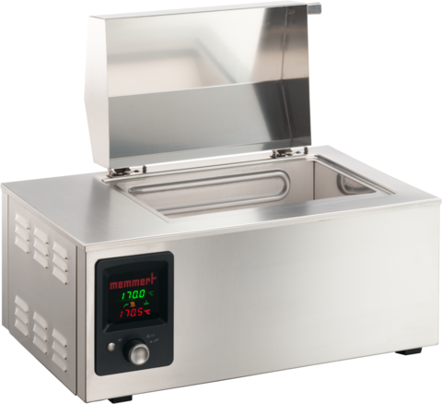
Memmert
Oil Bath one 7
Setting temperature range: +20 to +200 °C
Timer: digital timer from 1 min. up to 999 hours for: ON (continuous operation), DELAYED ON, HOLD or HOLD set-temperature dependent with guaranteed holding time

Slide 9
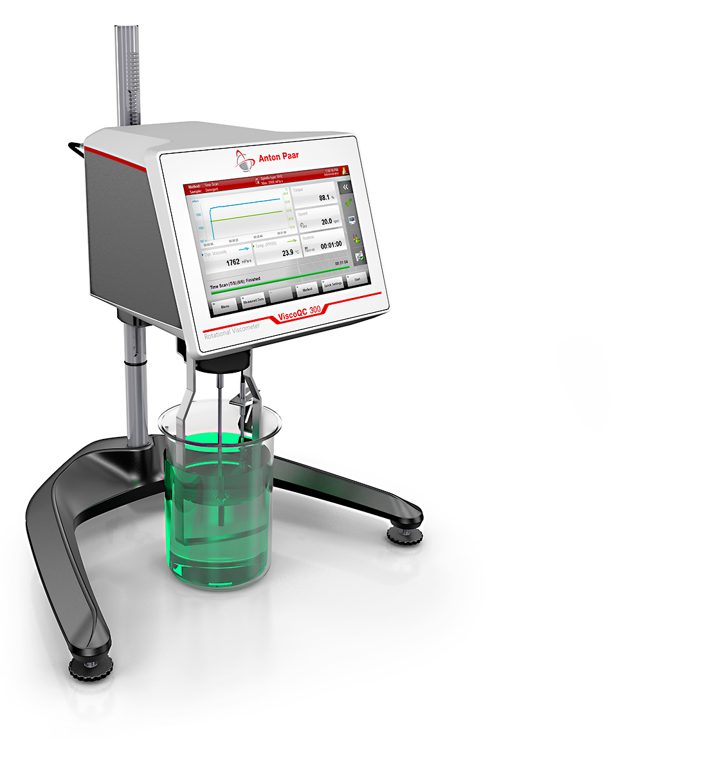
Anton-Paar
Viscometer, ViscoQC 300
Accuracy: ±1.0 % full scale range
Viscosity range [mPa.s]: 10** to 40M
Speed [rpm]: 0.01 to 250
Speedlist with 18 standard speeds
Freely selectable speeds within the speed range

Slide 10
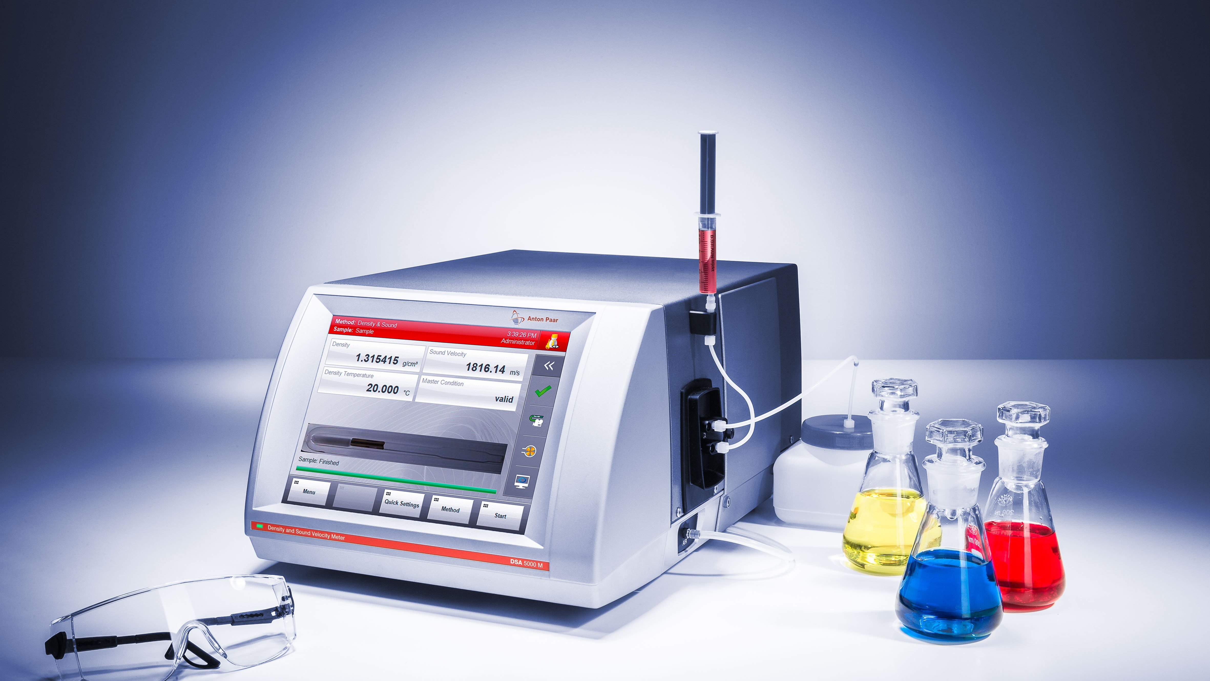
Anton-Paar
Densitometer, DMA 1001
Accuracy: Density: 0.0001 g/cm³
Temperature: 0.05 °C (0.09 °F)
Digital Resolution: Density: 0.00001 g/cm³
Temperature: 0.01 °C (0.01 °F
Measuring range: Density: 0 g/cm³ to 3 g/cm³
Pressure: 0 bar to 10 bar (0 psi to 145 psi)

Slide 11
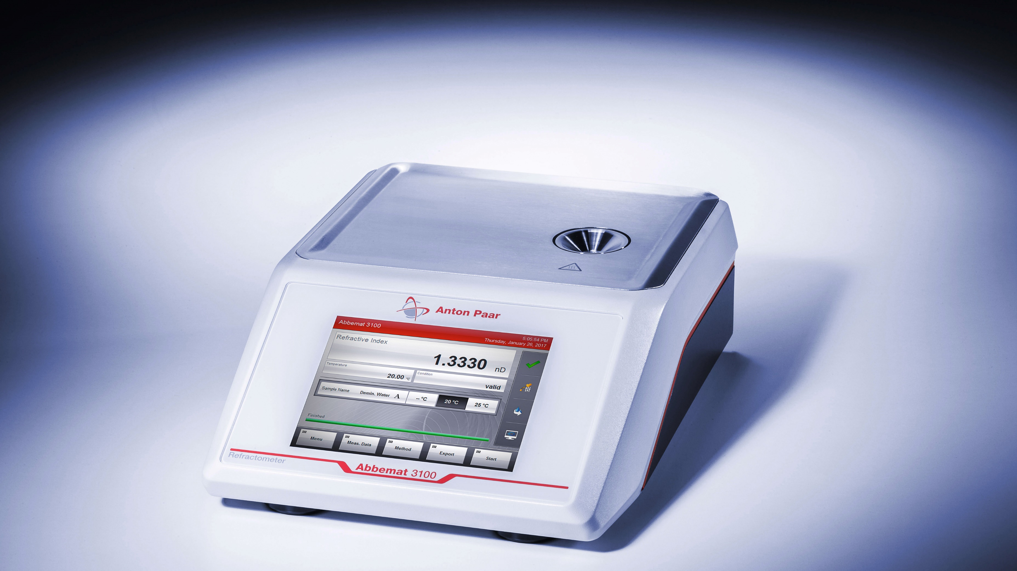
Anton-Paar
Refractometer, Abbemat 3100
Brix Range: 0 to 100 %
Accuracy nD: ± 0.0001
Refractive index Range nD: 1.30 to 1.66

Slide 12
Equipment
Quantification
Analysis
Qualification
Analysis
General
Equipment
08
01
05
Mettler
Moisture Analyzer
pH-Conductometer
Weight Scale (0.01/0.0001)
Anton-Paar
Refractometer
Densitometer
Viscometer
Olympus
Microscope
Shimadzu
UV Spectrophotometer
Memmert
Oil Bath
Drying Oven
IKA
Mechanical Stirrer
Hotplate-Stirrer

